Slide 1

Security+
Exam SY0-601
Chapter 34
Risk Management
Notes:
Gain Attention

Slide 2
Chapter 34 (Domain 5.4) Learning Objectives
Summarize risk management processes and concepts.
Risk types
External
Internal
Legacy systems
Multiparty
IP theft
Software compliance/licensing
Risk management strategies
Acceptance
Avoidance
Transference
Cybersecurity insurance
Mitigation
Risk analysis
Risk register
Risk matrix/heat map
Risk control assessment
Risk control self-assessment
Risk awareness
Inherent risk
Residual risk
Control risk
Risk appetite
Regulations that affect risk posture
Risk assessment types
Qualitative
Quantitative
Likelihood of occurrence
Impact asset value
Single-loss expectancy (SLE)
Annualized loss expectancy (ALE)
Annualized rate of occurrence (ARO)

Slide 3
Chapter 34 (Domain 5.4) Learning Objectives
Summarize risk management processes and concepts.
Disasters
Environmental
Person-made
Internal vs. external
Business impact analysis
Recovery time objective (RTO)
Recovery point objective (RPO)
Mean time to repair (MTTR)
Mean time between failures (MTBF)
Functional recovery plans
Single point failure
Disaster recovery plan (DRP)
Mission essential functions
Identification of critical systems
Site risk assessment

Slide 4
Risk Management
Risk management is a core business function of an enterprise because it is through the risk management process that an enterprise can maximize its return on investments.
Understanding the business impact of operations associated with the enterprise is key for business success.
This can be accomplished using a business impact analysis.
Using the data from the analysis, coupled with a threat analysis and a risk assessment process, the enterprise can come to an understanding of the sources of the risk elements it faces and their level of intensity.

Slide 5
Risk Types
External threats
Come from outside the organization and, by definition, begin without access to the system.
Access is reserved for users who have a business need to know and have authorized accounts on the system.
Outsiders must first hijack one of these accounts.
This extra step and the reliance on external connections typically make external attackers easier to detect.

Slide 6
Risk Types
Internal threats
Include disgruntled employees and well-meaning employees who make mistakes or have an accident. Internal threats tend to be more damaging, as the perpetrator has already been granted some form of access.
The risk is related to the level of access and the value of the asset being worked on.
For instance, if a system administrator working on the domain controller accidently erases a critical value and crashes the system, it can be just as costly as an unauthorized outsider performing a DoS attack against the enterprise.

Slide 7
Risk Types
Legacy systems
Older, pre-existing systems.
Technical debt is the cost occurred over time as a result of not maintaining a system completely.
A common reason for not updating or upgrading a system is that it will break something or void some warranty in place.
In a world with constantly evolving threats and risk vectors, the inability to respond is a risk in itself.

Slide 8
Risk Types
Multiparty
When a system has multiple parties, each with its own risk determinations, the management of the overall risk equation gets complicated.
If a firm is negotiating to make a major system change, and all the stakeholders are within the firm, then it is still considered a single party.
If the financing for the project is from another firm, and subcontractors are involved, other party determinations of acceptable risk levels become an issue very quickly.

Slide 9
Risk Types
IP (Intellectual Property) Theft
IP theft can seriously damage a company’s future health.
Unlike physical assets, digital assets can be stolen merely through copying, and this is the pathway attackers use for IP data.
IP theft is hard to attribute, and once the copy is in the marketplace, the only resort is courts via trade secret and patent protection actions.
This is a very significant issue with international state-sponsored attacks, as the legal recourses are challenging to use effectively.
Investigation and prosecution of IP theft are major items pursued by the FBI as part of its cybersecurity strategy.

Slide 10
Risk Types
Software Compliance/Licensing
The source of this software is via licensing and in many cases trust.
Copies of many software products can be made and used without licenses, and this creates software compliance/licensing risk.
This form of risk is best battled using policies and procedures that prohibit the activity, followed by internal audits that verify compliance with the policies.

Slide 11
Risk Management Strategies
Risk management can best be described as a decision-making process.
Risk management strategies include elements of threat assessment, risk assessment, and security implementation concepts, all positioned within the concept of business management.
When you manage risk, you determine what could happen to your business, you assess the impact if it were to happen, and you decide what you could do to control that impact as much as you or your management team deems necessary.
It is an iterative, ongoing process.

Slide 12
Risk Management Strategies
Risks cannot be removed or eliminated.
You can take actions to change the effects that a risk poses to a system, but the risk itself doesn’t really change, no matter what actions you take to mitigate that risk.
A high risk will always be a high risk.
Strategies to reduce risk:
Avoid
Transfer
Mitigate
Accept

Slide 13
Risk Management Strategies
Understand that risk cannot be completely eliminated.
A risk that remains after implementing controls is termed a residual risk.
You have to further evaluate residual risks to identify where additional controls are required to reduce risk even more.

Slide 14
Acceptance
When you’re analyzing a specific risk, after weighing the cost to avoid, transfer, or mitigate a risk against the probability of its occurrence and its potential impact, the best response is to accept the risk.
However, there should always be some additional controls, such as a management review or a standardized approval process, to ensure the assumed risk is adequately managed.

Slide 15
Avoidance
Avoiding the risk can be accomplished in many ways.
Although you can’t remove threats from the environment, you can alter the system’s exposure to the threats.
Not deploying a module that increases risk is one manner of risk avoidance.

Slide 16
Transference
Transference of risk is when the risk in a situation is covered by another entity.
The mistake many make is assuming the risk transfers.
The only risk transference that occurs across these legal agreements is that defined in the contract.
Cybersecurity Insurance
A common method of transferring risk is to purchase cybersecurity insurance. Insurance allows risk to be transferred to a third party that manages specific types of risk for multiple parties, thus reducing the individual cost.

Slide 17
Mitigation
Risk can also be mitigated through the application of controls that reduce the impact of an attack.
Controls can alert operators so that the level of exposure is reduced through process intervention.
When an action occurs that is outside the accepted risk profile, a second set of rules can be applied, such as calling the customer for verification before committing a transaction.
Controls such as these can act to reduce the risk associated with potential high-risk operations.

Slide 18
Risk Analysis
To manage risk, there needs to be a measurement of loss, and potential loss, and much of this information comes by way of risk analysis.
Risk analysis is performed via a series of specific exercises that reveal presence and level of risk across an enterprise.
Then, through further analysis, the information can be refined to a workable plan to manage the risk to an acceptable level.

Slide 19
Risk Register
A risk register is a list of the risks associated with a system.
It also can contain additional information associated with the risk element, such as categories to group like risks, probability of occurrence, impact to the organization, mitigation factors, and other data.
There is no standardized form.
The Project Management Institute has one format, other sources have different formats.
The reference document ISO Guide 73:2009 Risk Management—Vocabulary defines a risk register to be a “record of information about identified risks.”

Slide 20
Risk Matrix/Heat Map
A risk matrix or heat map is used to visually display the results of a qualitative risk analysis.
This method allows expert judgment and experience to assume a prominent role in the risk assessment process and is easier than trying to exactly define a number for each element of risk.
To assess risk qualitatively, you first determine the likelihood of a threat occurring and also the consequence should it occur.
You then take the value of each and multiply them together to get the risk value.

Slide 21
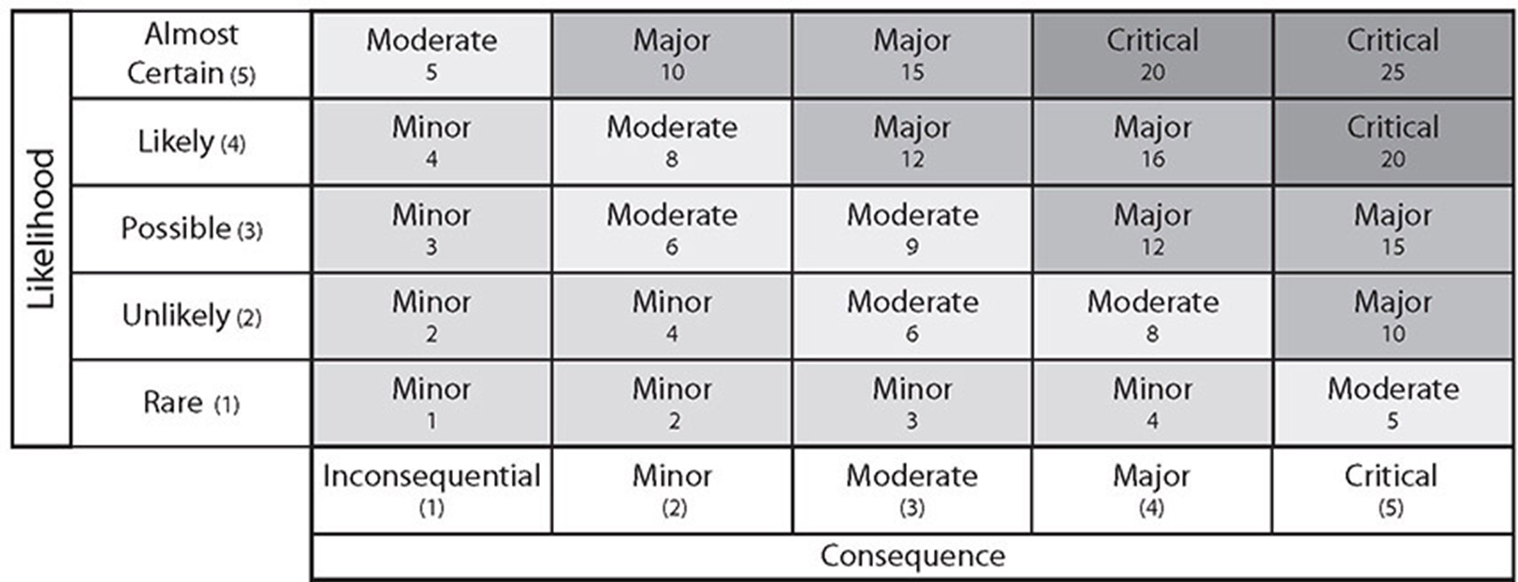
Risk Matrix/Heat Map

Slide 22
Risk Control Assessment
A risk control assessment is a tool used by the Financial Industry Regulatory Authority (FINRA) to assess a series of risks associated with their member institutions.
Questions are asked about a wide range of topics, including cybersecurity.
Answers to these questions paint a fairly detailed picture of the potential risk exposures a firm has, given its policies and practices.

Slide 23
Risk Control Self-Assessment
Risk control self-assessment is a technique that employs management and staff of all levels to identify and evaluate risks and associated controls.
This information is collected and analyzed to produce a more comprehensive map of risks and the controls in place to address it.
Engaging multiple viewpoints in the collection of information, identifying risk exposures and determining corrective actions, provides different perspectives and can uncover unnoticed vulnerabilities.

Slide 24
Risk Awareness
Risk awareness is knowledge of risk and consequences.
Risk awareness is essential for wide ranges of personnel, with the content tailored to their contributions to the enterprise.
Workers need to understand the risks and defenses against social engineering.
System designers need to understand risk and vulnerabilities of the systems.
Management and executives need to understand the whole risk ecosystem.

Slide 25
Inherent Risk
Inherent risk is defined as the amount of risk that exists in the absence of controls.
This can be confusing, as the definition of “no controls” could include no access controls, no door locks, no personnel background checks—in essence an environment that would equate to everything becoming high risk.
Inherent risk is the current risk level given the existing set of controls rather than the hypothetical notion of an absence of any controls.
And as the environment changes, so can the inherent risk.

Slide 26
Residual Risk
The presence of risks in a system is an absolute—they cannot be removed or eliminated.
As mentioned previously in this chapter, four actions can be taken to respond to risk: accept, transfer, avoid, and mitigate.
Whatever risk is not transferred, mitigated, or avoided is referred to as residual risk and, by definition, is accepted.
You cannot eliminate residual risk, but you can manage risk to drive residual risk to an acceptable level.

Slide 27
Control Risk
Control risk is a term used to specify risk associated with the chance of a material misstatement in a company’s financial statements.
This risk can be manifested in a couple ways: either there isn’t an appropriate set of internal controls to mitigate a particular risk, or the internal controls set in place malfunctioned.
Business systems that rely on IT systems have an inherent risk associated with cybersecurity risks.
What makes these risks become control risks is when they impact the business function in a manner that results in financial misstatements or errors.
In the case of an organization that doesn’t have adequate internal controls in place to prevent and detect fraud or errors, it has a specific issue of control risk as opposed to inherent risk.

Slide 28
Risk Appetite
Risk appetite is the term used to describe a firm’s tolerance for risk.
This risk appetite is related to other business elements such as reward and loss.
Each company’s executive structure needs to determine the appropriate risk appetite for that firm, and that becomes the upper limit on acceptable risk in the company’s operations.

Slide 29
Regulations That Affect Risk Posture
Regulations can have a dramatic effect on risk exposure.
Sometimes that effect is a direct action of a regulation, such as financial firms being forced by regulators to have
Certain levels of encryption to protect certain types of processes. Other times it is less direct, as in specific monitoring required for reporting, and firms change operations to avoid having to report.
Regulations drive corporate responses because failing to follow regulations can result in penalties, which represent a loss.
Therefore, regulations can be viewed as risks with almost certainty of incurring the loss.

Slide 30
Risk Assessment Types
A risk assessment is a method to analyze potential risk based on statistical and mathematical models.
You can use any one of a variety of models to calculate potential risk assessment values.
A common method is the calculation of the annual loss expectancy (ALE). Calculating the ALE creates a monetary value of the impact.
This calculation begins by calculating a single-loss expectancy (SLE), which is presented in detail later in the chapter.

Slide 31
Qualitative vs Quantitative
Qualitative risk assessment is the process of subjectively determining the impact of an event that affects a project, program, or business.
Qualitative risk assessment usually involves the use of expert judgment and models to complete the assessment.
Quantitative risk assessment is the process of objectively determining the impact of an event that affects a project, program, or business.
Quantitative risk assessment usually involves the use of metrics and models to complete the assessment.

Slide 32
Likelihood of Occurrence
The likelihood of occurrence is the chance that a particular risk will occur.
This measure can be qualitative or quantitative, as just discussed.
For qualitative measures, the likelihood of occurrence is typically defined on an annual basis so that it can be compared to other annualized measures.
If defined quantitatively, it is used to create rank-order outcomes.

Slide 33
Impact
The impact of an event is a measure of the actual loss when a threat exploits a vulnerability.
Federal Information Processing Standard (FIPS) 199 defines three levels of impact using the terms high, moderate, and low.
The impact needs to be defined in terms of the context of each organization.
Impacts can be in terms of cost (dollars), performance (service level agreement [SLA] or other requirements), schedule (deliverables), or any other important item.
Impact can also be categorized in terms of the information security attribute that is relevant to the problem: confidentiality, integrity, and availability.

Slide 34
Life
Many IT systems are involved in healthcare, and failures of some of these systems can and have resulted in injury and death to patients.
IT systems are also frequently integral to the operation of machines in industrial settings, and their failure can have similar impacts.
Injury and loss of life are outcomes that backups cannot address and can result in consequences beyond others.
As part of a business impact analysis (BIA), you would identify these systems and ensure that they are highly redundant, to avoid impact to life.

Slide 35
Property
Property damage can be the result of unmitigated risk.
Property damage to company-owned property, property damage to property of others, and even environmental damage from toxic releases in industrial settings are all examples of damage that can be caused by IT security failures.
This can be especially true in companies that have manufacturing plants and other cyber physical processes.

Slide 36
Safety
Safety is the condition of being protected from or unlikely to cause danger, risk, or injury.
Safety makes sense from both a business risk perspective and when you consider the level of concern one places for the well-being of people.
In a manufacturing environment, with moving equipment and machines that can present a danger to workers, government regulations drive specific actions to mitigate risk and make the workplace as safe as possible.
Unsafe conditions that are the result of computer issues will face the same regulatory wrath that unsafe plants have caused in manufacturing—fines and criminal complaints.

Slide 37
Finance
Finance is in many ways the final arbiter of all activities because it is how we keep score.
We can measure the gains through sales and profit, and we can measure the losses through unmitigated risks.
We can take most events, put a dollar value on them, and settle the books.
Where this becomes an issue is when the impacts exceed the expected costs associated with the planned residual risks because then the costs directly impact profit.
Lost profits
Ransomware
Fines
Lawsuits
Loss of reputation

Slide 38
Reputation
Corporate reputation is important in marketing.
Would you deal with a bank with a shoddy record of accounting or losing personal information?
How about online retailing?
Would the customer base think twice before be entering their credit card information after a data breach?
These are not purely hypothetical questions; these events have occurred, and corporate reputations have been damaged as a result, thus costing the firms in customer base and revenue.

Slide 39
Asset Value
The Asset Value (AV) is the amount of money it would take to replace an asset.
This term is used with the Exposure Factor (EF), a measure of how much of an asset is at risk, to determine the Single-Loss Expectancy (SLE).
SLE = AV × EF
ALE = SLE × ARO

Slide 40
Annualized Rate of Occurrence (ARO)
The Annualized Rate of Occurrence (ARO) is a representation of the frequency of the event, measured in a standard year.
If the event is expected to occur once in 20 years, then the ARO is 1/20.
Typically, the ARO is defined by historical data, either from a company’s own experience or from industry surveys.

Slide 41
Disasters
Disasters are major events that cause disruptions.
The timescale of the disruption can vary, as can the level of disruption, but the commonality is that the external event that caused the disruption is one that cannot be prevented.
Common disasters include weather-related events and events that everyone knows will happen eventually, just not where or when.
Person-made disasters can be as simple as a misconfiguration that results in the loss of a significant amount of data.
Hurricanes, earthquakes, tornados, volcanos, COVID-19

Slide 42
Person-made
Person-made threats are those that are attributable to the actions of a person.
But these threats aren’t limited to hostile actions by an attacker; they include accidents by users and system administrators.
Users can represent one of the greatest risks in an IT system.
Proper controls to manage the risk to a system must include controls against both accidental and purposeful acts.

Slide 43
Internal vs. External
Internal threats have their origin within an organization, whereas external risks come from the outside.
When disasters are examined, they can be seen to have originated either within the company or outside the company.
If supply chain decisions are made to go with a single overseas vendor for a minor price advantage, with no backup, and then a disaster strikes the country of the supplier, is this an internal or external risk?
It can be viewed as both, but an internal policy decision drives the risk of going with a single vendor.

Slide 44
Business Impact Analysis
Business impact analysis (BIA) is the process used to determine the sources and relative impact values of risk elements in a process.
It is also the name often used to describe a document created by addressing the questions associated with sources of risk and the steps taken to mitigate them in the enterprise.
The BIA also outlines how the loss of any of your critical functions will impact the organization.

Slide 45
Recovery Time Objective (RTO)
The term Recovery Time Objective (RTO) is used to describe the target time that is set for the resumption of operations after an incident.
This is a period of time that is defined by the business, based on the needs of the business.
A shorter RTO results in higher costs because it requires greater coordination and resources.
This term is commonly used in business continuity and disaster recovery operations.

Slide 46
Recovery Point Objective (RPO)
Recovery Point Objective (RPO), a totally different concept from RTO, is the time period representing the maximum period of acceptable data loss.
The RPO defines the frequency of backup operations necessary to prevent unacceptable levels of data loss.
A simple example of establishing RPO is to answer the following questions:
How much data can you afford to lose?
How much rework is tolerable?

Slide 47
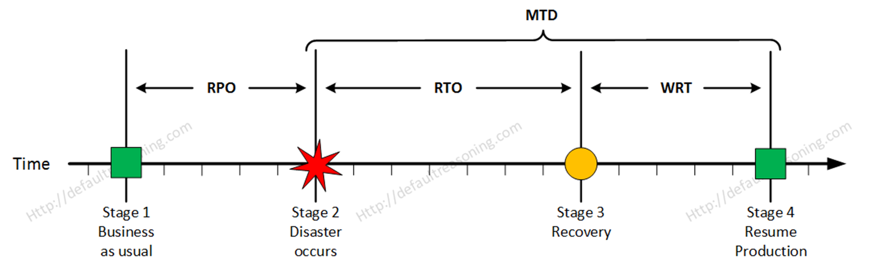
RTO vs RPO

Slide 48
Mean Time to Repair (MTTR)
Mean Time To Repair (MTTR) is a common measure of how long it takes to repair a given failure.
This is the average time, and it may or may not include the time needed to obtain parts.
MTTR = (total downtime) / (number of breakdowns)
Availability is a measure of the amount of time a system performs its intended function.
Reliability is a measure of the frequency of system failures.

Slide 49
Mean Time Between Failures (MTBF)
Mean Time Between Failure (MTBF) is a common measure of reliability of a system and is an expression of the average time between system failures.
The time between failures is measured from the time a system returns to service until the next failure.
Mean time to failure (MTTF) is a variation of MTBF, one that is commonly used instead of MTBF when the system is replaced in lieu of being repaired.

Slide 50
Functional Recovery Plans
Functional recovery plans
The transition from operations under business continuity back to normal operations.
Disaster operations is fast and prioritized.
Functional recovery is more organized and staged over time.

Slide 51
Single Point of Failure
A key principle of security is defense in depth.
This layered approach to security is designed to eliminate any specific single point of failure (SPOF).
A single point of failure is any system component whose failure or malfunctioning could result in the failure of the entire system.
For mission-essential systems, single points of failure are items that need to be called to management’s attention, with full explanation of the risk and costs associated with them.

Slide 52
Disaster Recovery Plan (DRP)
A Disaster Recovery Plan (DRP) is the plan a firm creates to manage the business impact of a disaster and to recover from its impacts.

Slide 53
Mission-Essential Functions
Mission-essential functions are those that, should they not occur or be performed properly, will directly affect the mission of the organization.
In other terms, mission-essential functions are those that must be restored first after a business impact to enable the organization to restore its operations.

Slide 54
Identification of Critical Systems
A part of identifying mission-essential functions is identifying the systems and data that support the functions.
Identification of critical systems enables the security team to properly prioritize defenses to protect the systems and data in a manner commensurate with the associated risk.
It also enables the proper sequencing of restoring operations to ensure proper restoration of services.

Slide 55
Site Risk Assessment
Risk assessments can have specific characteristics associated with different sites.
This is the basis for a site risk assessment, which is simply a risk assessment tailored for a specific site.
In organizations with multiple locations, with differing systems and operations, having tailored risk assessments that are specific to the risks associated with each site provides information for the firm.
There may be some elements that overall are specific to the firm, but the development and inclusion of the risks associated with each site provide an actionable document that can be used effectively.

